Slide 1

Tata Unistore Digital Analytics Proposal
Scope and Timelines
03/05/2016
The information contained in the document is proprietary to Tata Industries Limited- Tata Insights & Quants Division and is strictly confidential. In consideration of receipt of this document, the recipient agrees that the information is being shared only for the limited purpose. The recipient of this information further agrees to maintain such information in confidence and to not reproduce, disclose, duplicate, electronically transmit or use in whole or in part for any other purpose. Prior written consent shall be obtained from the Insights & Quants Division of Tata Industries in case the information is necessitated to be shared with anyone other than the Recipient to whom this information is addressed. The above restriction shall not limit the right to use the information contained in this deck, if it is obtained from another source without restriction.
© Copyright, Tata Insights & Quants Division, Tata Industries Limited

Slide 2



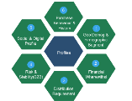











About Tata iQ
Our goal is to be India’s premier Omni-channel Marketing Solutions & Decision Sciences company powered by the richest and most valuable database, and high impact insights and analytics
Analytic Services
Largest and Richest Database
Collaboration and One Tata
Campaigns
Customer Insight &
Prospecting
Proprietary
Offline
Data
ShopsAPP
Risk Analytics
Public
Affiliate
Marketing
Online
Data
TSSS’15
Supply Chain
Operations
Group-wide Loyalty
Internal
Advanced Analytic Solutions
Tata iQ Proprietary Database
Building One Tata
Profiling, Segmentation, Predictive Analytics, Machine Learning
Quantitative Analytics, Existing Customer management (cross-sell, up-sell), Pricing, Channel, Store, Online, Assortment, Risk, Digital, Operations, Prospecting
900MM People Base
300 MM Enriched Base
Data across Individuals & Institutions
  Unified customer view, Maximize Revenue
  Minimize Expenses,
  Encompassing Loyalty mitigate risks, superior customer experience, sales/revenue growth
Confidential Property of Tata Industries Ltd – Tata Insights & Quants Division

Slide 3
Digital Analytics
Confidential Property of Tata Industries Ltd – Tata Insights & Quants Division

Slide 4



Digital & Social Analytics by Tata iQ
A. Web Analytics
B. Website Competitive Insights
C. Social Analytics
Website Diagnosis
Lead Funnel Analysis
Website Feature Analysis
Personalization
Segmentation & Retargeting
Social Reach & Engagement
Sentiment Analysis
Voice of Customer
Brand Topic
Social Campaign
Digital Benchmarking
Traffic Source Insights
Keywords Analysis
Customer Journey
Confidential Property of Tata Industries Ltd – Tata Insights & Quants Division

Slide 5





Customer Intelligence
Digital Maturity Model
Omni-Channel
Basic Measurement
Marketing Effectiveness
Personalization
Return on Investment ( ROI )
Post Campaign Analysis of Marketing Channels Performed for Tata AIG
Basic Analysis on Website & Social Media Performed for Tata AIG
Current State of Tata Unistore
Requires : Integration with Marketing Channels
Requires : Mobile App, Social Media Integration
Requires : CRM Integration
Requires : Web Analytic tool
Requires : A/B & MVT Testing Tools
Advanced Digital Analytics
Confidential Property of Tata Industries Ltd – Tata Insights & Quants Division

Slide 6
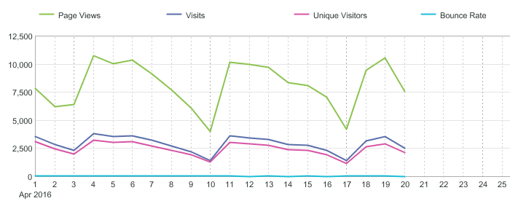
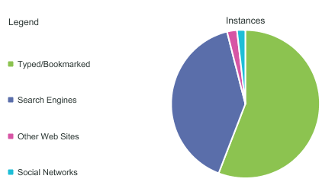
Web Analytics by Tata iQ : Leveraging Adobe Analytics
Standard Reports in Adobe
Customized Reports using Adobe
Basic Website Metrics
Example:
Web traffic trends segmented based on visitor segments , devices , geography and channels
Performance of website pages/section in terms of views and engagement over time
Traffic source performance mapping with respect to Campaign tracking code & business needs
Business Diagnosis
Example:
Opportunities to effectively increase quality traffic on website
Attribution analysis of traffic trends to market or internal events
Weak and strong aspects of website in terms of content and features
Traffic Source Reports
Confidential Property of Tata Industries Ltd – Tata Insights & Quants Division

Slide 7
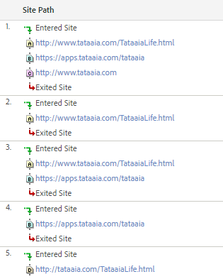
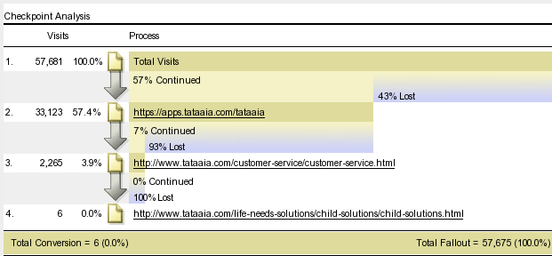
Web Analytics by Tata iQ : Leveraging Adobe Analytics
Standard Reports in Adobe
Customized Reports using Adobe
Example:
Top website Paths segmented based on visitor type, devices , geography and channels
Customized funnel performance to understand visitors’ behaviour over website
Path Report
Funnel Report
Business Diagnosis
Example:
Possible solutions to impediments faced by customer for micro-conversions on website – Lead Form / Customer service etc.
Suggestion on landing pages optimization & website structure for improved lead conversion and engagement on website
……….
Confidential Property of Tata Industries Ltd – Tata Insights & Quants Division

Slide 8
Digital Analytics: Website Performance
Input from Adobe Analytics
Analysis
Techniques
Output
Recommendations On
Markov Chain Model
Optimized Paths
Website Structure
Customized Report :
Clickstream Data– Visitor level
Fallout Report
Page Reports
Event Data
Visitor / Visit Clustering
Visitor Persona
Targeting for Marketing Campaigns
Multivariate Regression
Website Feature Analysis
Website Structure / UX
Feedback
Confidential Property of Tata Industries Ltd – Tata Insights & Quants Division

Slide 9





Web Analytics Detailed Capabilities
Area | Outcomes
Website Diagnosis | Measure Performance of Key Business Metrics Measure Performance of customized variables and success events Measure Performance across Devices & Channels
Lead Funnel Analysis | Improving Lead Submission using Visitor Path Analysis Segmenting visitor based on paths Understanding Top paths and their conversion rate
Website Feature Analysis | Usage and Performance of Website Features such as links, buttons etc.
Segmentation & Retargeting | Integrating Web Analytics into Digital Campaign Planning for Optimized Results
Personalization | Improved website structure and marketing campaign by performing A/B testing
Confidential Property of Tata Industries Ltd – Tata Insights & Quants Division

Slide 10
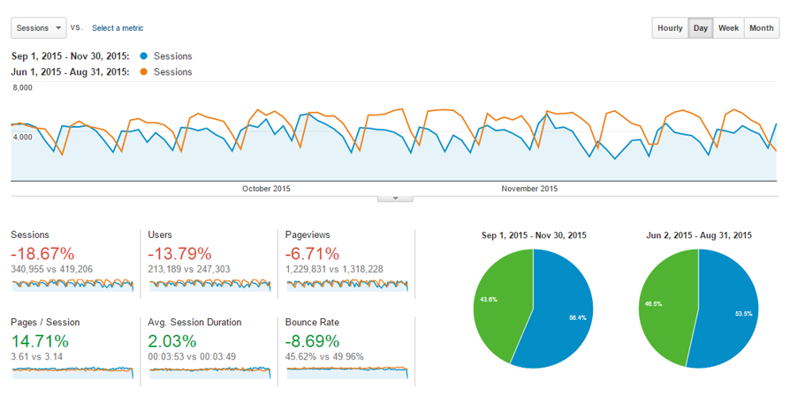
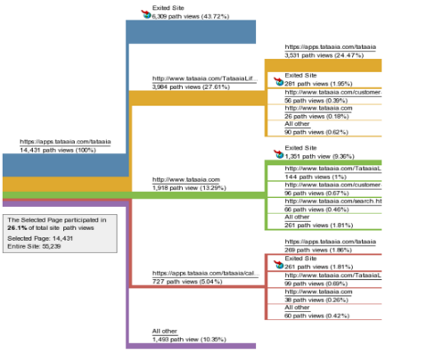
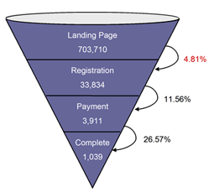
Website Diagnosis & Funnel Analysis
Key Website Metrics
Customer Journey
Product Conversion Funnels
Confidential Property of Tata Industries Ltd – Tata Insights & Quants Division

Slide 11
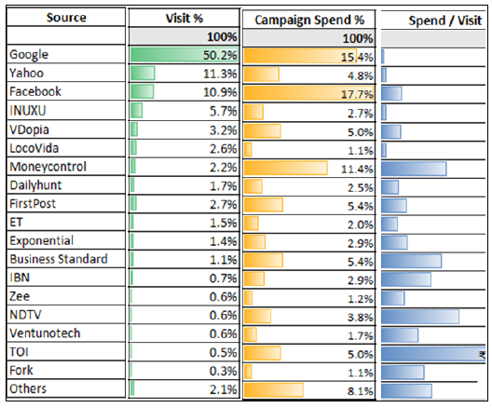
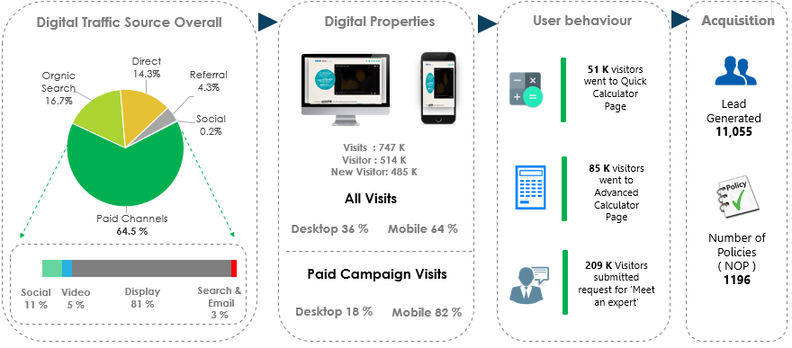
Digital Marketing Effectiveness
Channel Effectiveness
Campaign Effectiveness
Confidential Property of Tata Industries Ltd – Tata Insights & Quants Division

Slide 12




Website Competitive Insights & Recommendations
Area | Outcomes
Digital Benchmarking | Website Traffic Estimates – Desktop & Mobile Website Engagement – time on site , Bounce rate , page/visit Website Traffic trend and Insights
Traffic Source Insights | Analysis of digital marketing strategy of direct competitors by studying top website traffic sources : Referral Traffic – Top Referring website Paid Traffic – Top Ad networks Social – Top Social Channels
Keywords Analysis | Performance of Keywords among direct competitors in generating website traffic
Customer Journey | Top Website Sections and Pages on Competitor’s Website Estimate of Digital Business Performance and online customer journey on Competitor’s Website
Confidential Property of Tata Industries Ltd – Tata Insights & Quants Division

Slide 13
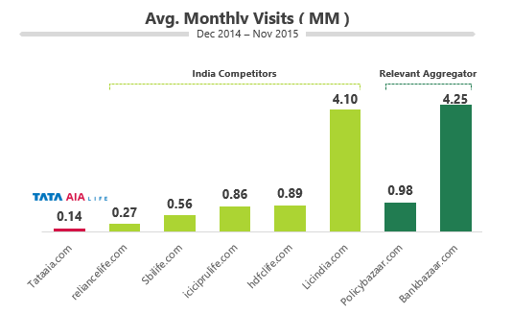
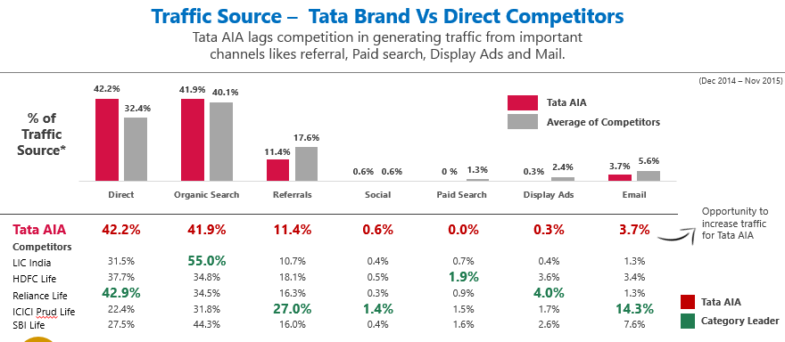
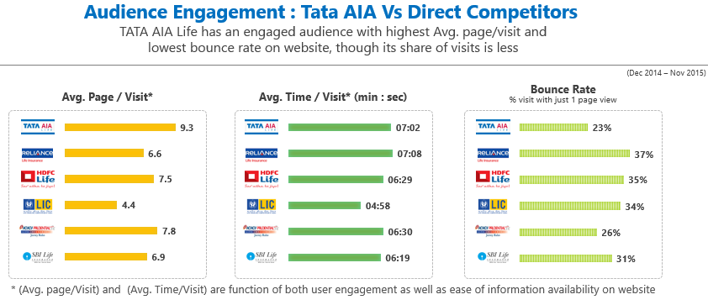
Digital Competitive Insights
Website Traffic
Traffic Source
Website Engagement
Confidential Property of Tata Industries Ltd – Tata Insights & Quants Division

Slide 14






Social Analytics & Competitive Insights
Area | Outcomes
Topic & Theme Analysis, Recommend content | Topic and Theme analysis of Competition Social Media presence Based on above, recommendations on content while building social media presence
Social Reach & Engagement | Monthly performance of brand across key Social Media KPI’s KPI’s benchmarked to top industry players
Sentiment Analysis | Monthly Sentiment Analysis benchmarking across social media
Voice of Customer | Customer topic detection Customer sentiment across topics and social channels
Brand Topic | Performance of Brand posts on social media across industry
Social Campaign | Performance of Social media Campaigns of direct competitors
Confidential Property of Tata Industries Ltd – Tata Insights & Quants Division

Slide 15
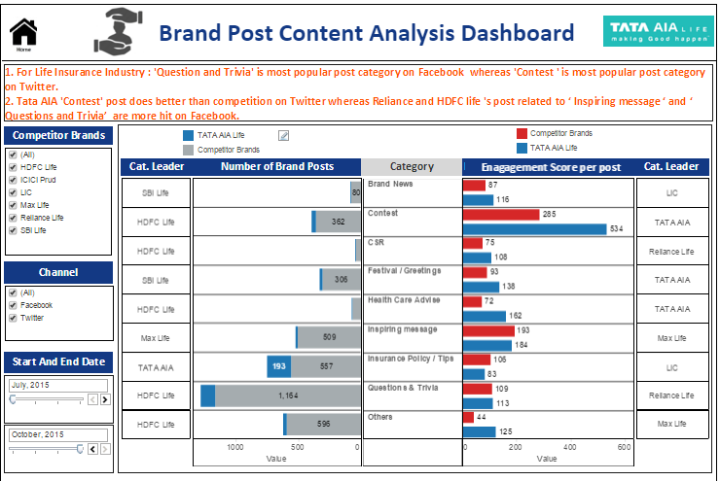
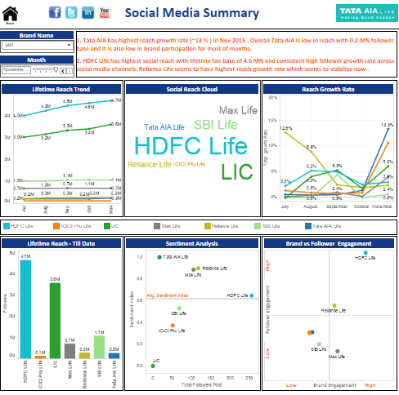
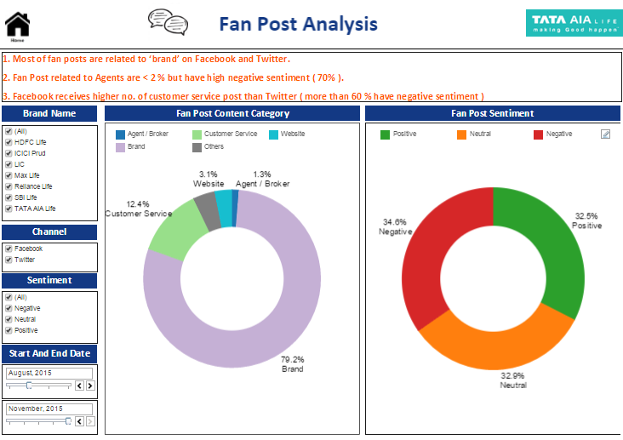
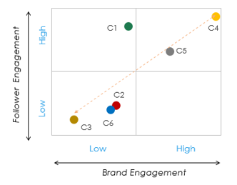
Social Reach & Engagement
Brand Content Analysis
Social Media Trend
Customer Topic Analysis
Social Benchmarking
Confidential Property of Tata Industries Ltd – Tata Insights & Quants Division

Slide 16
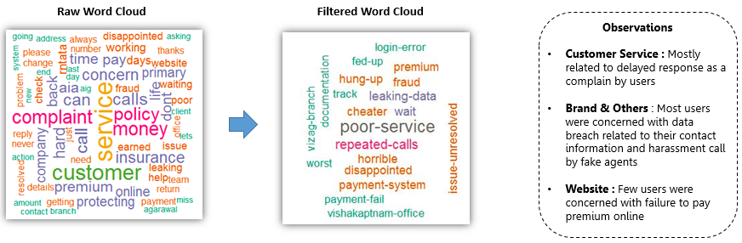

Voice of Customer & Sentiment Analysis
Word Cloud and Sentiments
Key Themes
Confidential Property of Tata Industries Ltd – Tata Insights & Quants Division

Slide 17
Social Perceptual Maps
Perceptual Map for Positive Opinion
Perceptual Map for Negative Opinion
Performance
AC
Interior
Mileage
Engine
Handling
Interior
Mileage
Space
Entertainment
Performance
AC
Interior
Build
Space
Appearance
Engine
Mileage
Space
Mileage
Appearance
Mileage
Interior
Entertainment
Engine
Handling
Performance
Interior
Mileage
Appearance
Engine
Handling
Interior
Build
Appearance
Performance
Mileage
Entertainment
Handling
Space
Engine
Tiago seems to be closest to Kwid both with regards to positive and negative opinion
Engine seems to be a major driver of negative opinion for a number of brands

Slide 18
Scope with Tata Unistore
Confidential Property of Tata Industries Ltd – Tata Insights & Quants Division

Slide 19

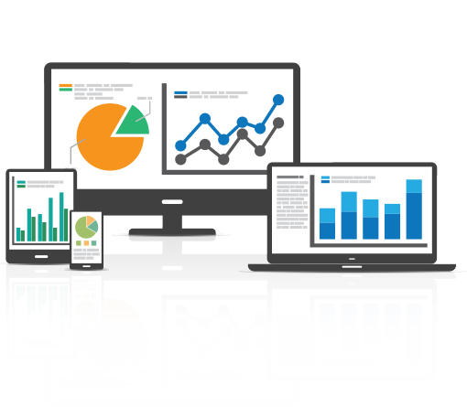

Tableau Reporting & Consulting
Efforts for below services are not factored currently
Tableau Reporting & Consulting *
Efforts dependent on :
a. Business Objective & Complexity
b. No. of Dashboard
c. Consulting Time Duration
Confidential Property of Tata Industries Ltd – Tata Insights & Quants Division

Slide 20
Tableau Case Studies
Confidential Property of Tata Industries Ltd – Tata Insights & Quants Division

Slide 21
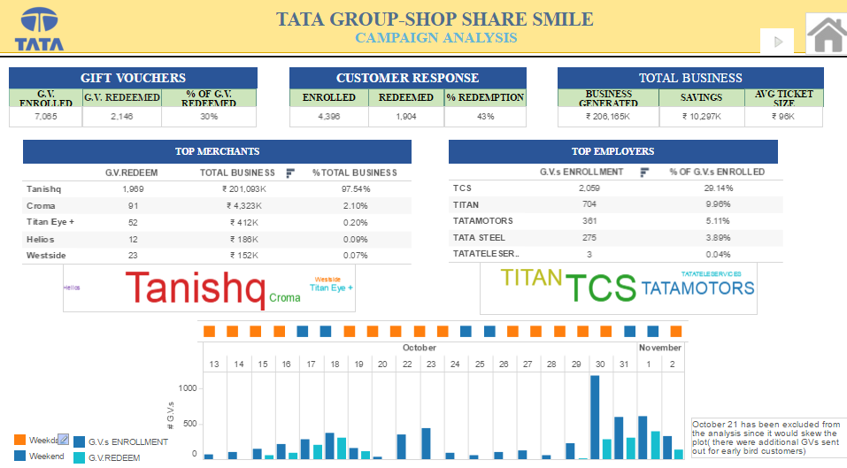
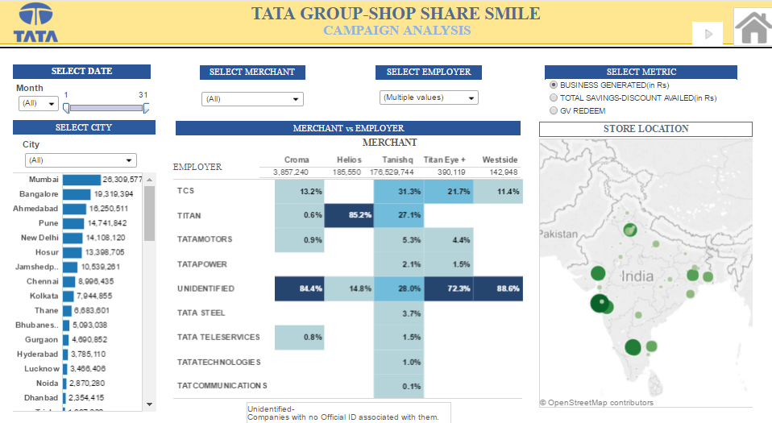
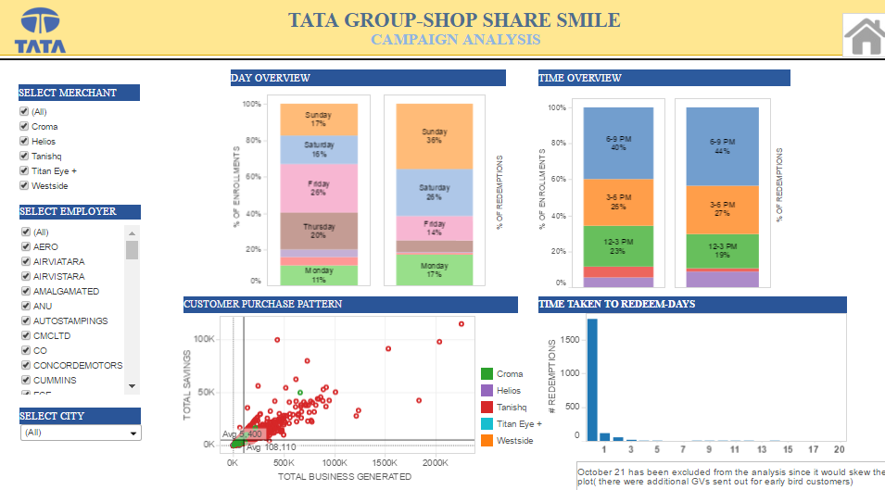
Tata iQ Case Study 1 : Campaign Performance – Group wide
Background
Methodology
Objective:
Tata Group wants to analyse the performance of ‘Shop Share & Smile’ Program.
Solution:
Tableau dashboard to highlight :
Key Business KPIs
Performance of Companies across geographies
Customer Purchase Pattern
Employee Redemptions
Result:
Effective campaign analysis providing insights for better targeting and personalization for next launch of program
Business KPI
Performance across Companies & Geography
Customer Purchase Pattern

Slide 22
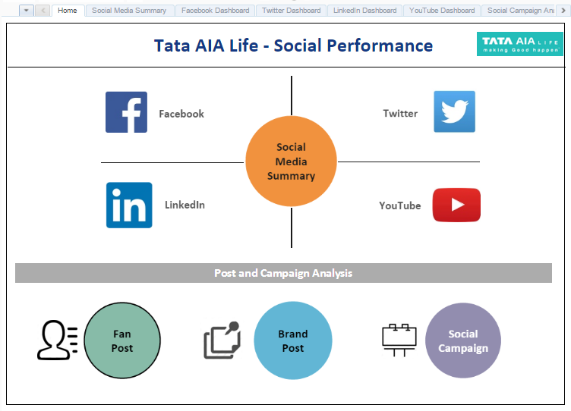
Tata iQ Case Study 2 : Life Insurance Domain - Social Analytics
Background
Methodology
Objective:
The leading Financial Services provider wants to analyse its social media presence with respect to other top Life insurance players in India .
Solution:
Monthly Tableau dashboard to highlight :
Brand Performance on each social media Channel
Topic and Sentiment analysis of Brand over time
Performance of Brand Content on social media
Result:
Client able to increase its social media reach (market leader for next 2 months in terms of growth), sentiment and response time over social media
Social Media Analytics across FB, Twitter, YouTube & LinkedIn
Competitor Benchmarking
Topic & Sentiment Analysis
Brand Content Analysis
Social Campaign Performance

Slide 23
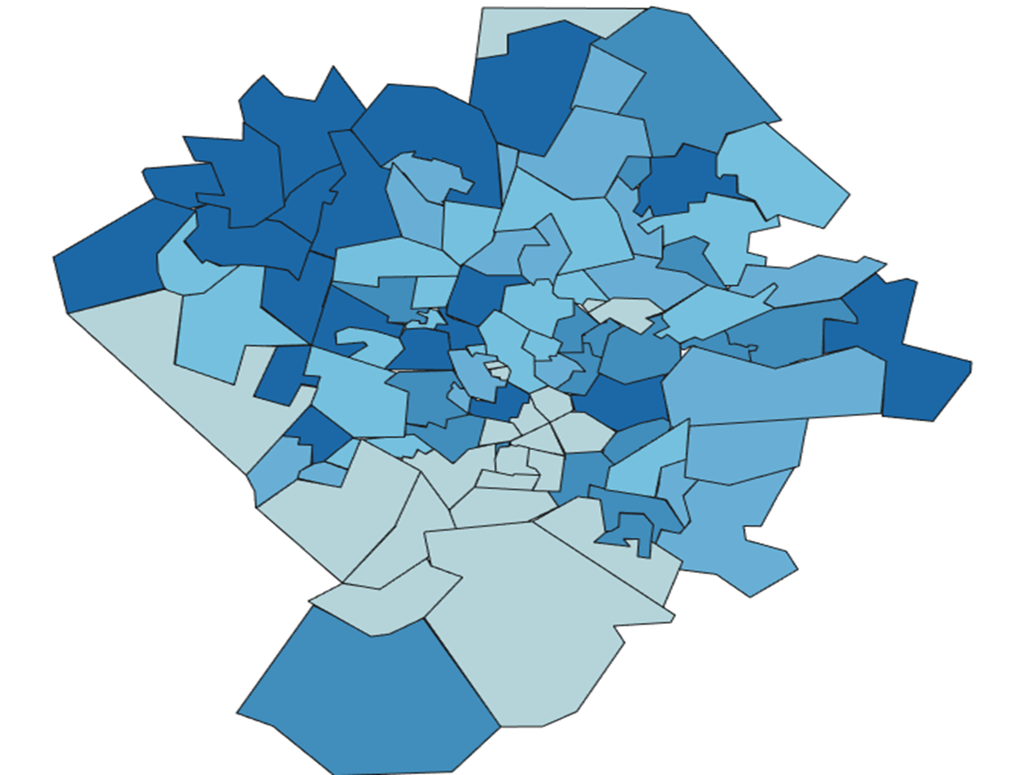

Tata iQ Case Study 3 : Electronics Retailer – Location Optimization
Background
Methodology
Store Location Attractiveness
Objective:
The retailer was looking to expand presence in the district of Hyderabad.
Solution:
Tableau visualization to highlight :
Catchment area attractiveness with respect to the retailer
Impact of Competitor presence
Potential Store locations with respect to catchment area attractiveness and competitor presence
Result :
The visualization and the solution helps understand
Relative attractiveness of planned store locations
Attractive locations as potential expansion opportunities
Potential of Catchment
Location Characteristics
Location Attractiveness model
Probability of Store Visit from Catchment
Store/Competitor Distance
Driving Distance to Store/Competitor PIN
Location map not to scale
Location map not to scale
Competitor 1
Competitor 2
Potential gradient – High to Low
Proposed Locations

Slide 24
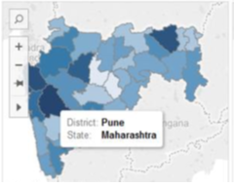
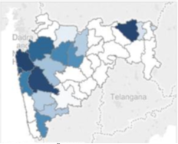
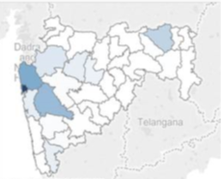
Tata iQ Case Study 4 : Financial Services - Business Loans Opportunities
Background
Methodology
Business Loan Opportunity
Objective:
The leading Financial Services provider has a selective but national presence with respect to Business Loans.
Solution:
Tableau visualization to highlight :
The most attractive locations for business loans
Market share in attractive and relatively less attractive locations
Sales presence vis a vis location attractiveness and market share
Result :
The visualization helps client to analyse :
Market share in high attractive locations
The locations with low market share which might be driven by low DSA presence
District Level Classification by Dimension
Business Loans Attractiveness
Market Share
DSA Presence

Slide 25
Thank You

